Slide 1
10/28/2024
El Conuco Restaurant
CST 2309
01
Maximo Antigua

Slide 2
Table of Contents
Introduction
Base
Wireframe
Website
Conclusion
02

Slide 3
Introduction
03

Slide 4
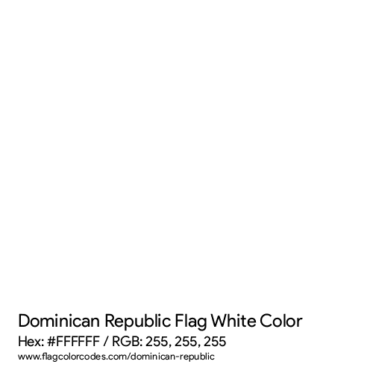
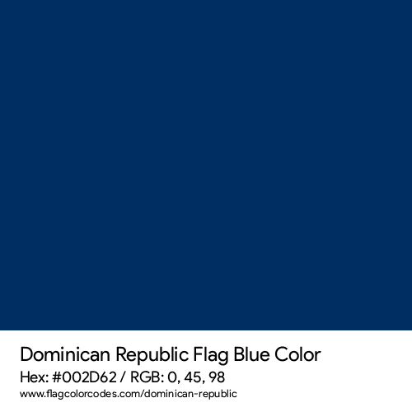
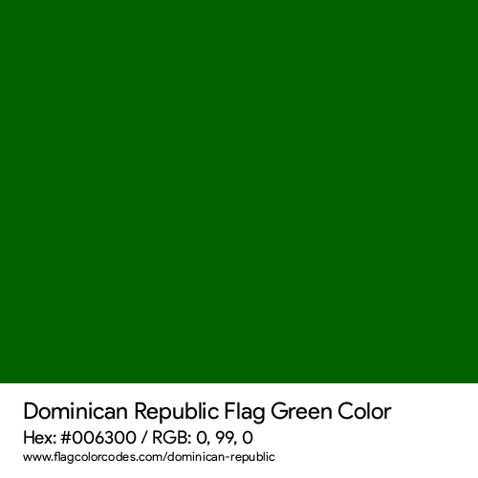
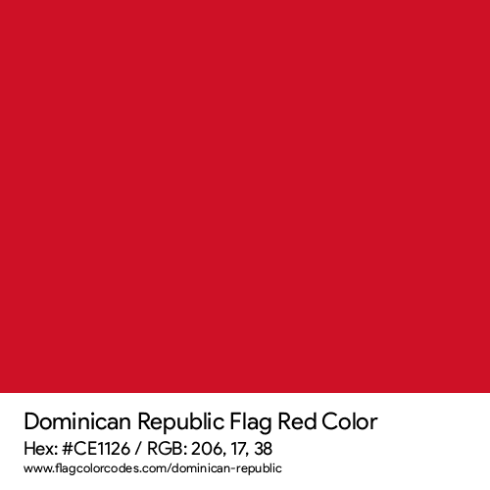
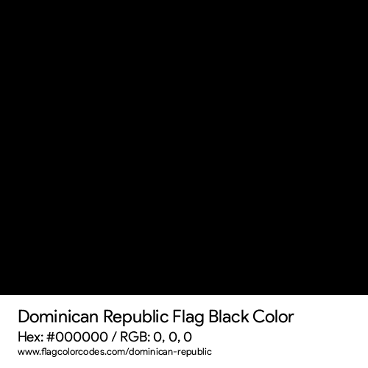
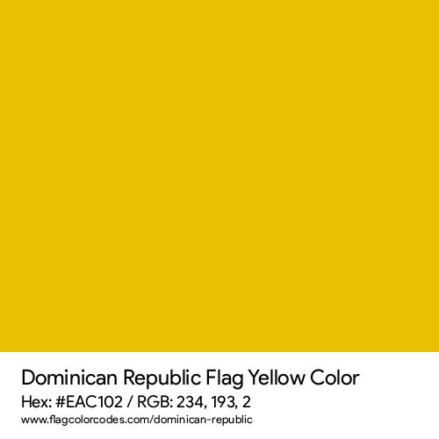
The Base of The Website
Colors
Inspiration
I got my ideas from Dominican Republic’s extensive cuisine, and culture.
Fonts
Risqué – Base of the Banner
Inter – Used for paragraphs
Mplus 1p Bold – Everything else
04

Slide 5
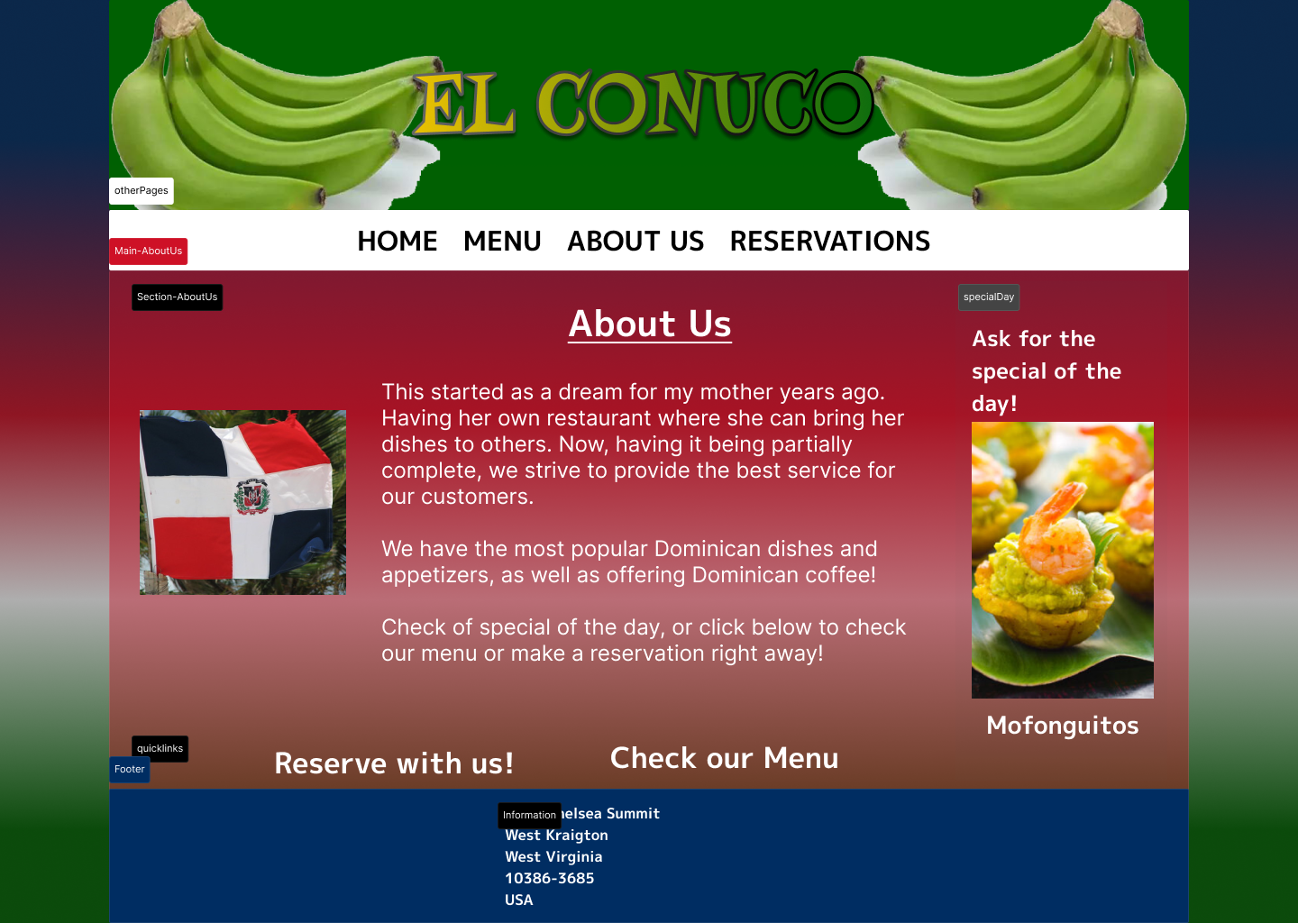
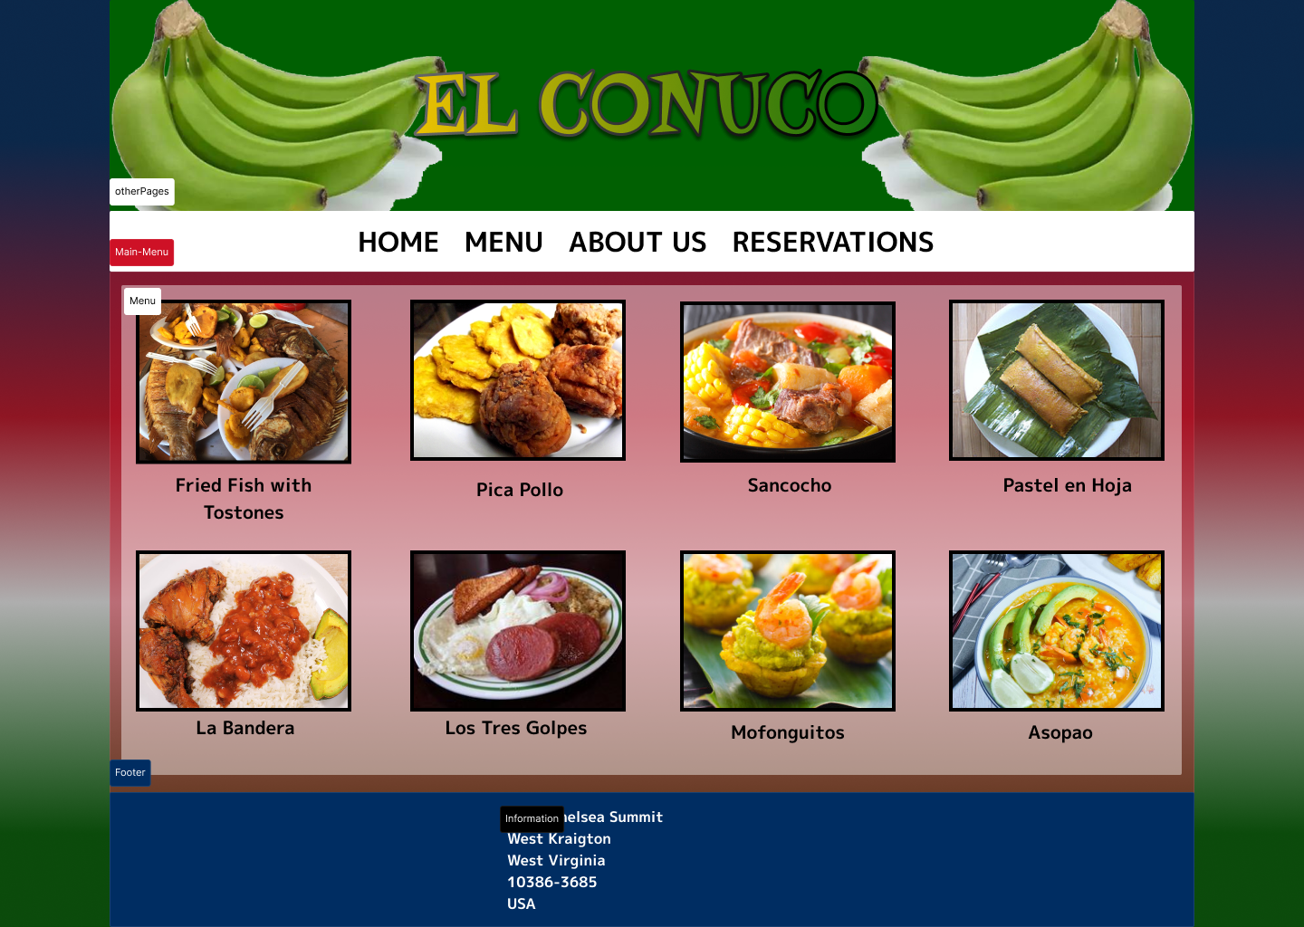
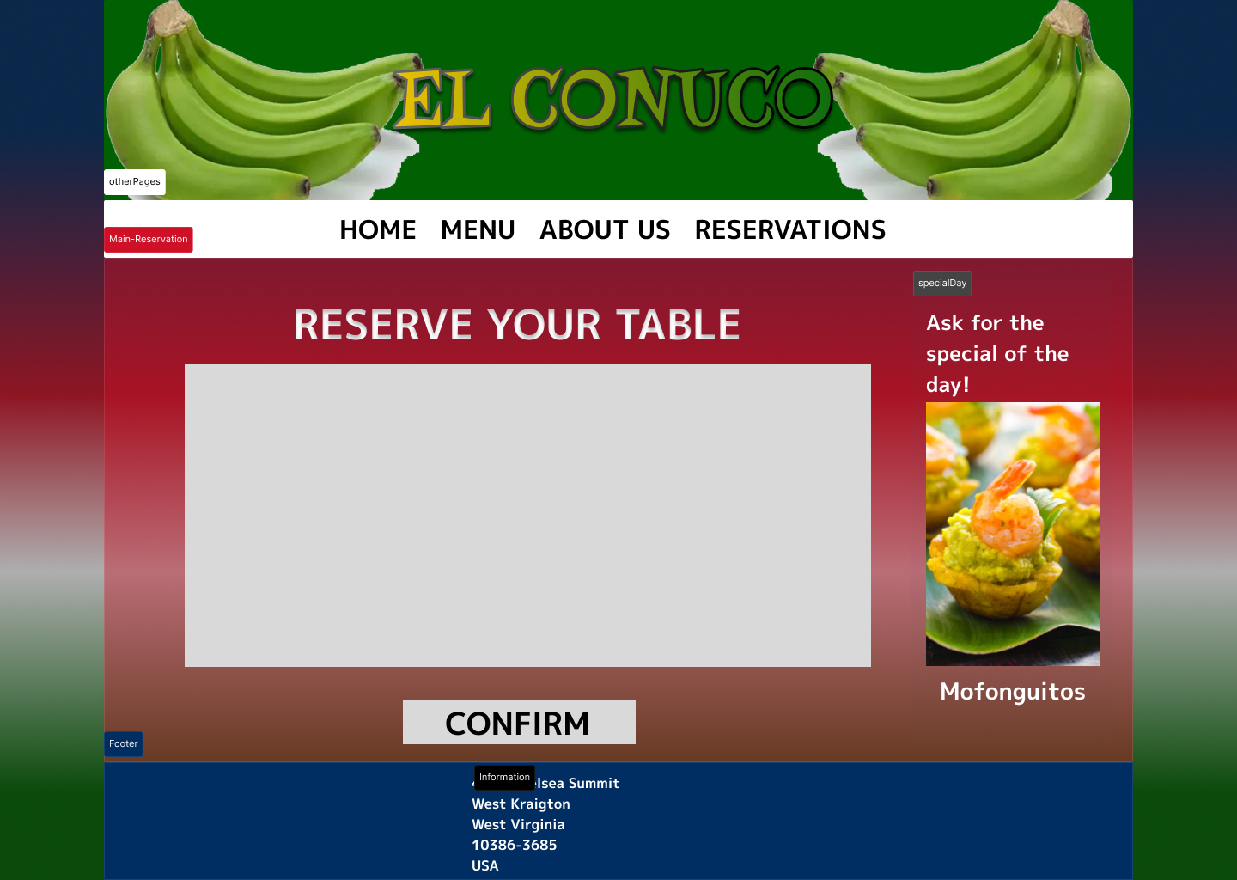
Wireframe
About Us
Menu
Reservations
05

Slide 6
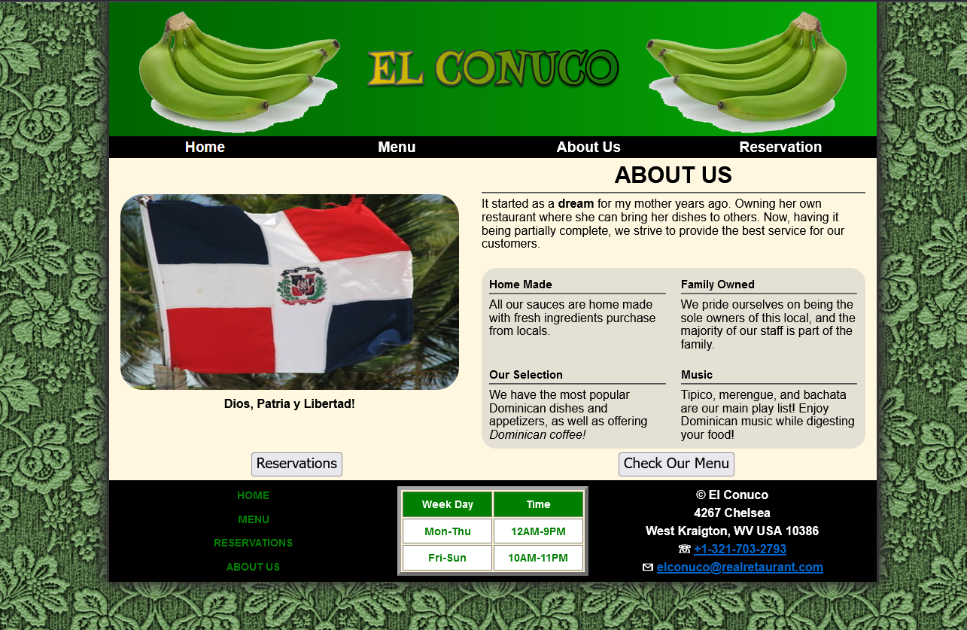
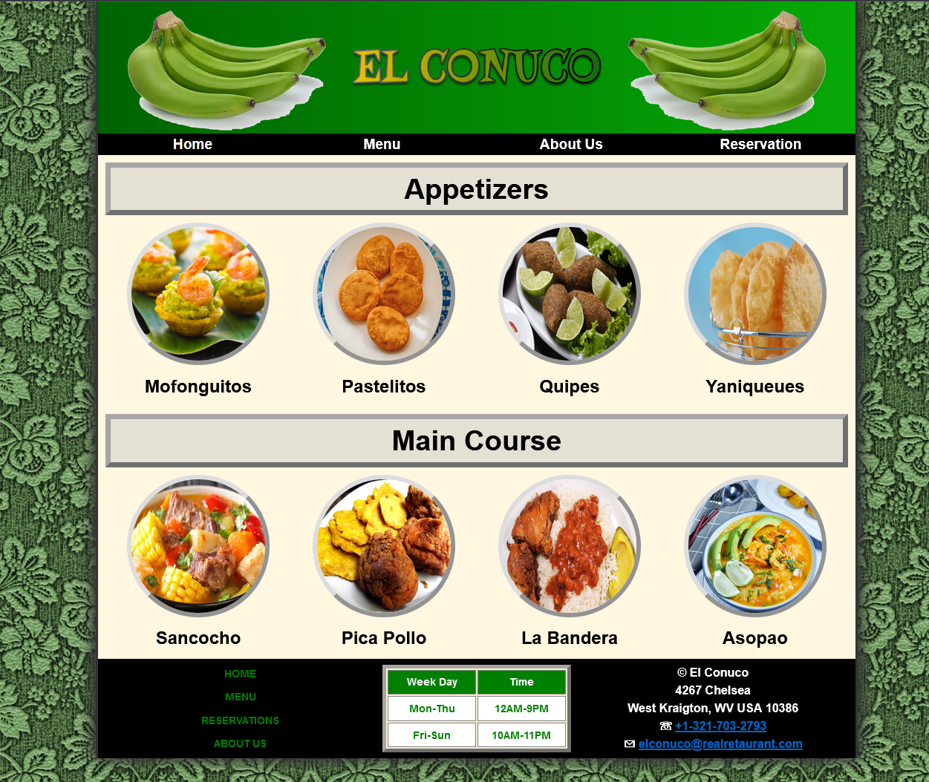
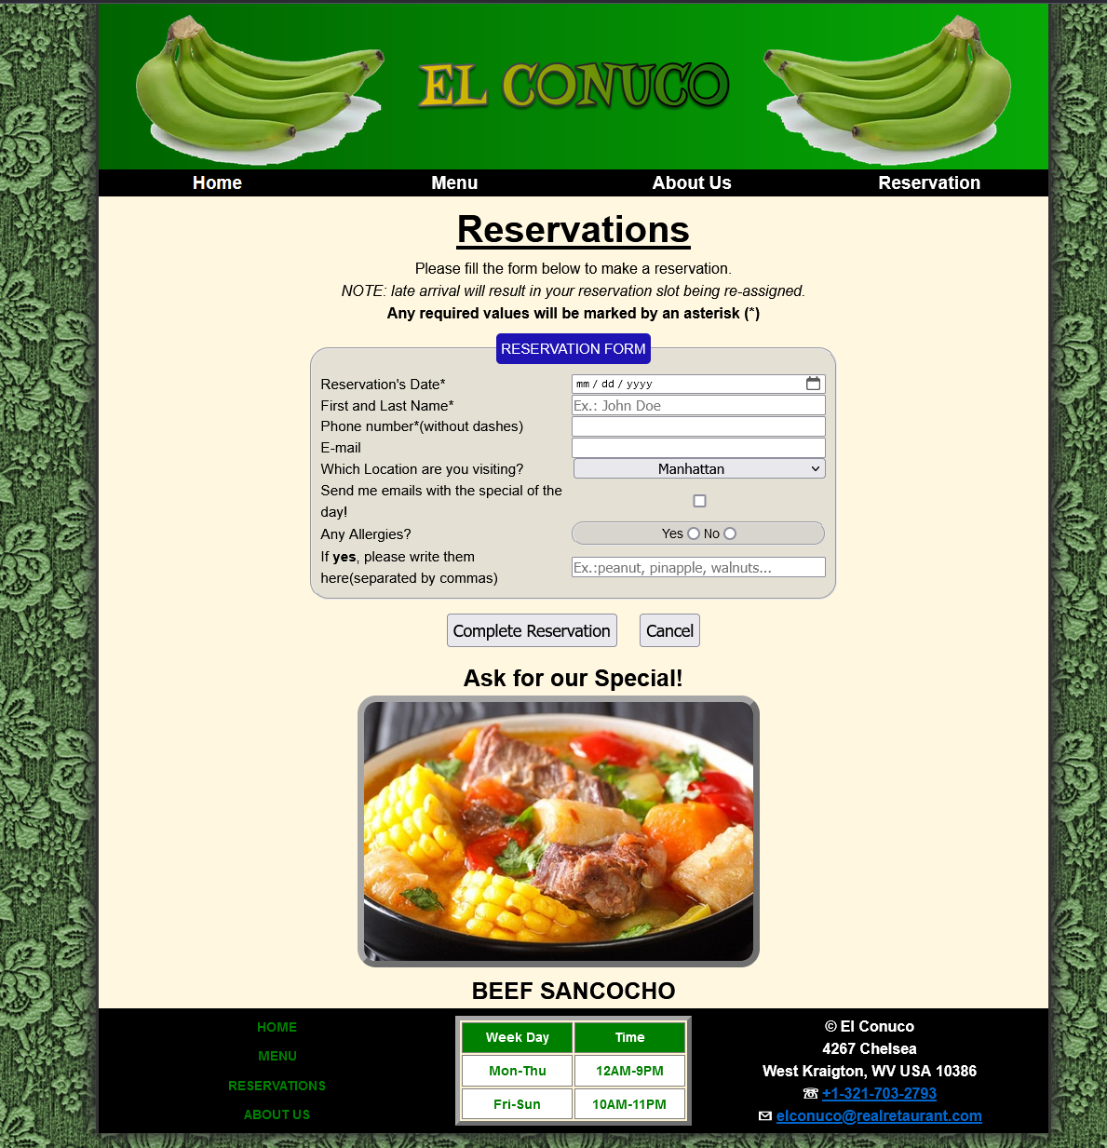
Website
El Conuco Website

Slide 7
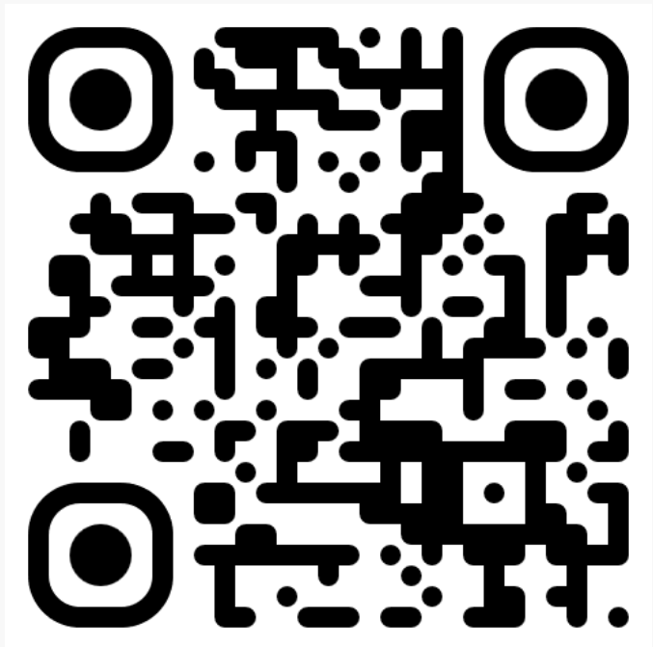

Conclusion
06

